Slide 1
Chapter 7
Electronic mail security
Qi Wenjing
Shandong Institute of Technology & Engineering ,China
http://www.sdai.edu.cn/
Wenjing_qi@21cn.com

Slide 2
Outline
Pretty good privacy
S/MIME
Recommended web sites

Slide 3
Email Security
Email is one of the most widely used network services
Currently message contents are not secure:
  May be viewed in transit on the network
    Main email protocols transmit data in the clear
  May be viewed by suitably privileged users on destination system (i.e. sys. administrator)
  Easy to masquerade as someone else
  Message integrity not guaranteed
Notes:
Current email services are roughly like "postcards". Anyone who wants could pick it up and have a look as its in transit or sitting in the recipients mailbox.

Slide 4
7.1 Pretty Good Privacy
Philip R. Zimmerman is the creator of PGP.
PGP provides a confidentiality and authentication service that can be used for electronic mail and file storage applications.

Slide 5
Why Is PGP Popular?
It is availiable free on a variety of platforms.
Based on well known algorithms.(which is considered extremly secure)
Wide range of applicability
Not developed or controlled by governmental or standards organizations

Slide 6
Operational Description
Consist of five services:
  Authentication
  Confidentiality
  Compression
  E-mail compatibility
  Segmentation
Notes:
1234

Slide 7
PGP Operation – Authentication
1. Sender creates a message
2. SHA1 used to create 160-bit hash of message
3. Hash code is encrypted using the sender's private key, and resulting signature is attached to message
4. Receiver uses sender's public key to decrypt attached signature and recover hash code
5. Receiver generates hash code of message and compares with decrypted hash code.
If match, message is accepted as authentic

Slide 8
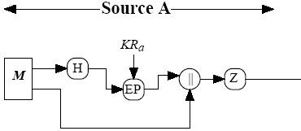
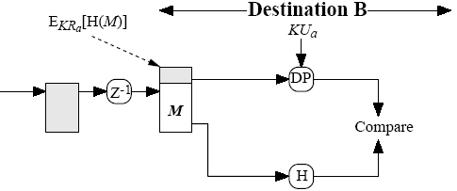
PGP Operation – Authentication
(book, fig 5.1a)
M = original message
H = hash function
| | = concatenation (join)
Z = compression
Z⁻¹ = decompression
EP = public key encryption
DP = public key decryption
KR_{a} = A’s private key
KU_{a} = A’s public key

Slide 9
PGP Operation – Confidentiality
1. Sender generates message and random number to be used as session key for this message only
2. Message is encrypted, using AES, 3DES, IDEA or CAST-128, with session key
3. Session key is encrypted using RSA with recipient's public key, then attached to msg
4. Receiver uses RSA with its private key to decrypt and recover session key
5. Session key is used to decrypt message

Slide 10

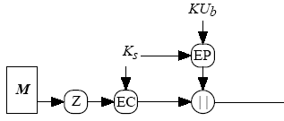

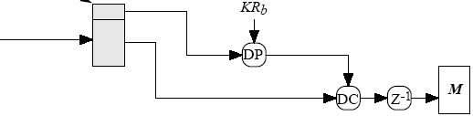
PGP Operation – Confidentiality
(book, fig 5.1b)
EC = symmetric encryption
DC = symmetric decryption
K_{s} = session key

Slide 11
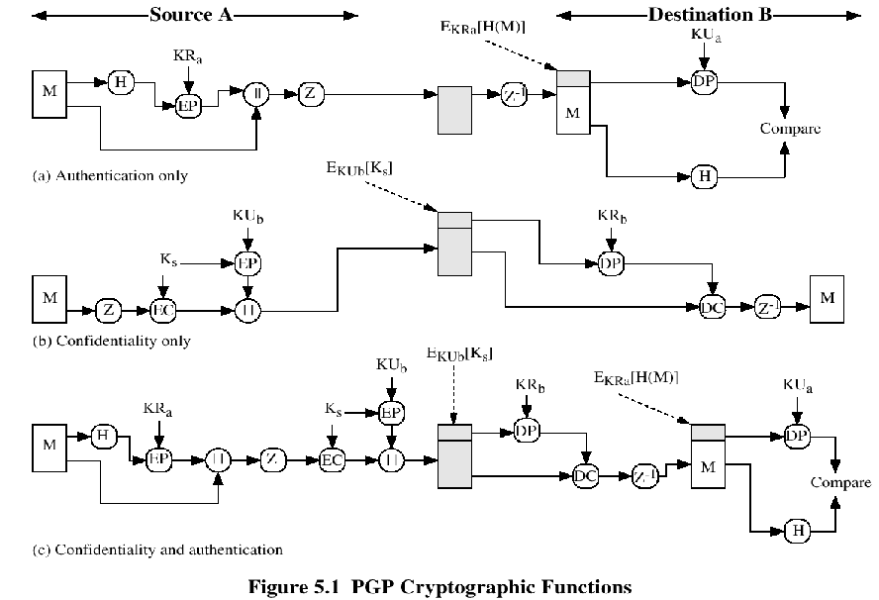

Slide 12
Compression
PGP compresses the message after applying the signature but before encryption
The placement of the compression algorithm is critical.
after signing the hash
  to save having to compress document every time you wish to verify its signature
  ZIP algorithm is not deterministic.
before encryption
  to speed up the process (less data to encrypt)
  for greater security; compressed messages are more difficult to cryptanalyse as they have less redundancy)
The compression algorithm used is ZIP (described in appendix 5A)

Slide 13
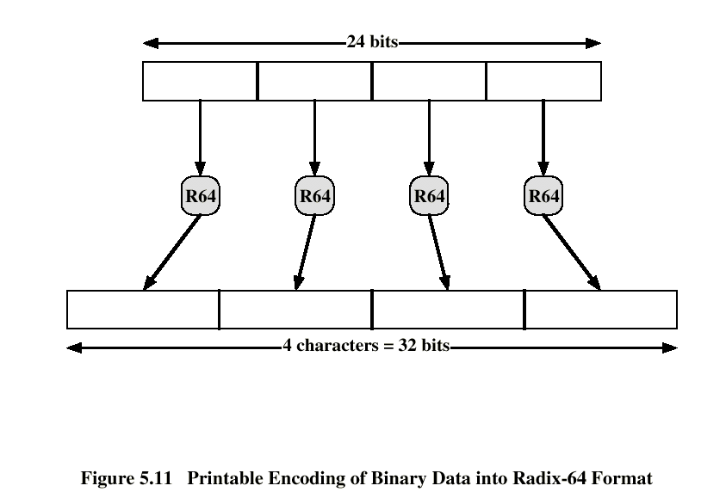
E-mail Compatibility
The scheme used is radix-64 conversion (see appendix 5B).
The use of radix-64 expands the message by 33%.

Slide 14
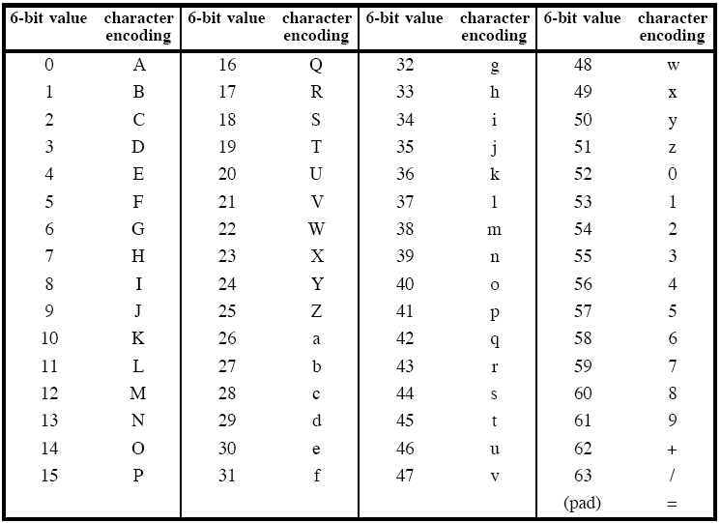
RADIX-64 Encoding

Slide 15
Segmentation and Reassembly
Often restricted to a maximum message length of 50,000 octets.
Longer messages must be broken up into segments.
PGP automatically subdivides a message that is to large.
The receiver strip of all e-mail headers and reassemble the block.

Slide 16
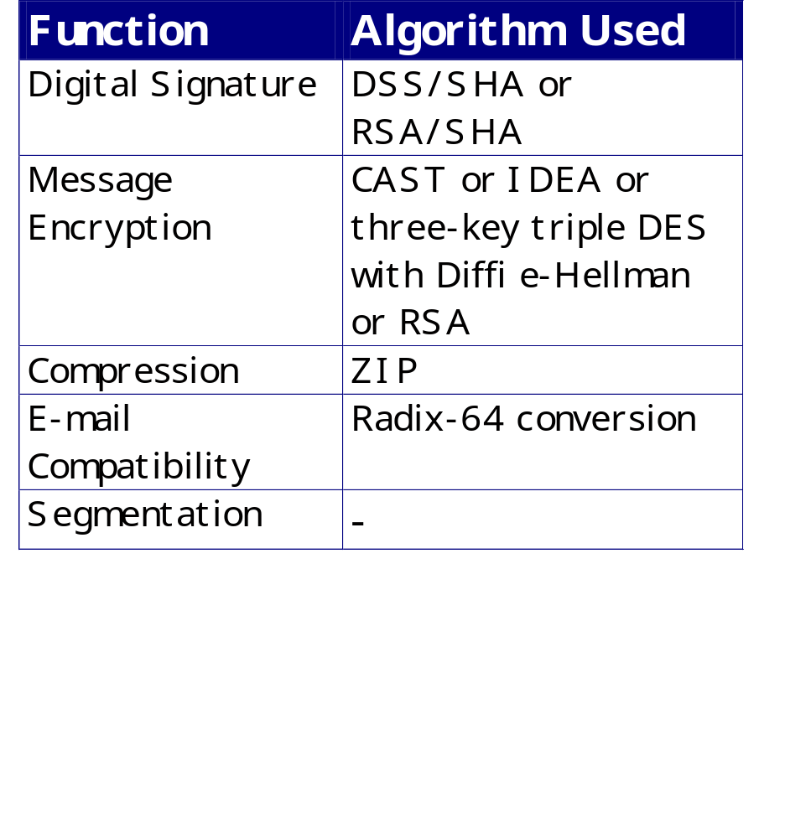
Sumary of PGP Services

Slide 17
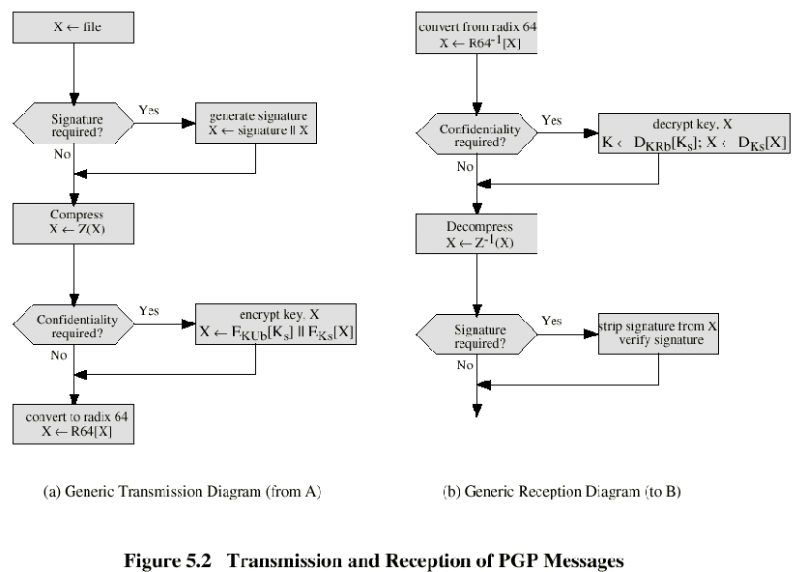

Slide 18
Cryptographic Keys and Key Rings
PGP makes use of four types of keys:
one-time session symmetric keys,
public keys,
private keys ,
passphrase-based symmetric keys

Slide 19
PGP Key Identifiers
Since many public/private keys may be in use, need to identify which is actually used for a given message
  Could send full public key with every message
  But this is inefficient
Rather use a key identifier (key ID) based on the key
  The least significant 64-bits of the key
  This will very likely be unique
Likewise use key ID in signatures

Slide 20
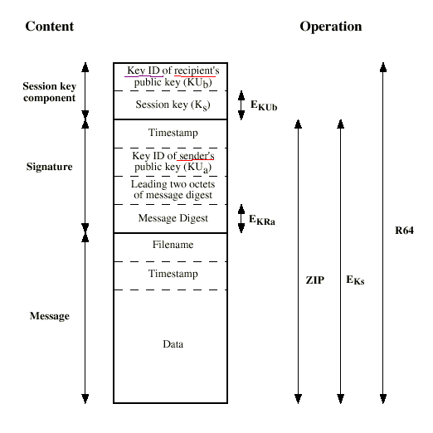
Format of
PGP
Message

Slide 21
PGP Key Rings
Each PGP user has a pair of key rings:
  Public-key ring contains all the public keys of other PGP users known to this user, indexed by key ID
  Private-key ring contains the public/private key pair(s) for this user, indexed by key ID & encrypted based on a hashed passphrase

Slide 22
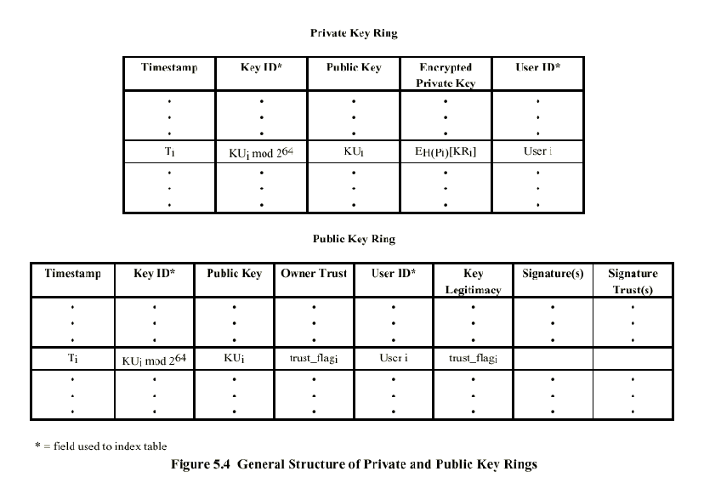

Slide 23
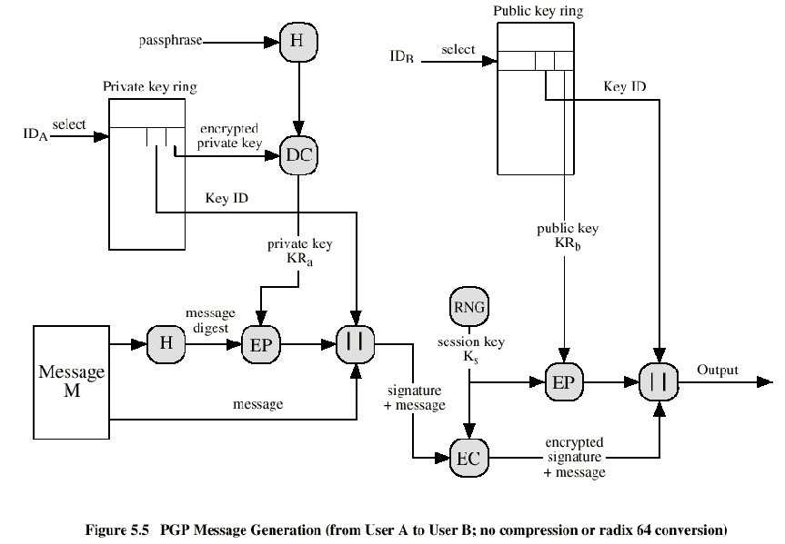

Slide 24
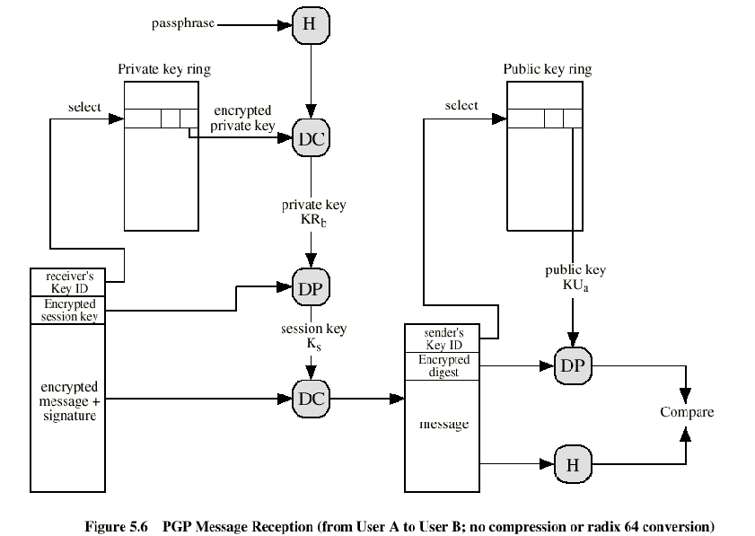

Slide 25
PGP Key Management
rather than relying on certificate authorities
in PGP every user is own CA
  can sign keys for users they know directly
forms a “web of trust”
  trust keys have signed
  can trust keys others have signed if have a chain of signatures to them
key ring includes trust indicators
users can also revoke their keys

Slide 26
The Use of Trust
Key legitimacy field
Signature trust field
Owner trust field
See Table 7.7 (W. Stallings , pp.240)

Slide 27
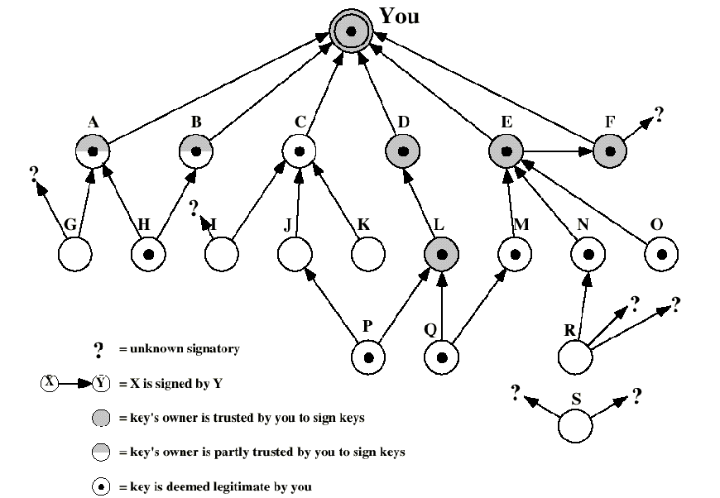

Slide 28
Revoking Public Keys
The owner issue a key revocation certificate.
Normal signature certificate with a revote indicator.
Corresponding private key is used to sign the certificate.

Slide 29
7.2 S/MIME
Secure/Multipurpose Internet Mail Extension
S/MIME will probably emerge as the industry standard.
PGP for personal e-mail security

Slide 30
Simple Mail Transfer Protocol (SMTP, RFC 822)
SMTP Limitations - Can not transmit, or has a problem with:
  executable files, or other binary files (jpeg image)
  “national language” characters (non-ASCII)
  messages over a certain size
  ASCII to EBCDIC translation problems
  lines longer than a certain length (72 to 254 characters)

Slide 31
S/MIME (Secure/Multipurpose Internet Mail Extensions)
security enhancement to MIME email
  original Internet RFC822 email was text only
  MIME provided support for varying content types and multi-part messages
  with encoding of binary data to textual form
  S/MIME added security enhancements
have S/MIME support in many mail agents
  eg MS Outlook, Mozilla, Mac Mail etc
Notes:
S/MIME (Secure/Multipurpose Internet Mail Extension) is a security enhancement to the MIME Internet e-mail format standard, which in turn provided support for varying content types and multi-part messages over the text only support in the original Internet RFC822 (now RFC5322) email standard. See text for discussion of these extensions. MIME is specified in RFCs 2045 through 2049. MIME allows encoding of binary data to textual form for transport over traditional RFC822 email systems. S/MIME support is now included in many modern mail agents.

Slide 32
S/MIME Messages
S/MIME secures a MIME entity with a signature, encryption, or both
forming a MIME wrapped PKCS object
have a range of content-types:
  enveloped data
  signed data
  clear-signed data
  registration request
  certificate only message
Notes:
S/MIME secures a MIME entity with a signature, encryption, or both. A MIME entity may be an entire message or one or more of the subparts of the message. The MIME entity plus some security related data, such as algorithm identifiers and certificates, are processed by S/MIME to produce a PKCS, which refers to a set of public-key cryptography specifications issued by RSA Laboratories. A PKCS object is then treated as message content and wrapped in MIME. A range of S/MIME content-types are specified, as shown. See text for details of how these are used.

Slide 33
S/MIME Enhanced Security Services
3 proposed enhanced security services:
  signed receipts
  security labels
  secure mailing lists
Notes:
As of this writing, three enhanced security services have been proposed in an Internet draft, and may change or be extended. The three services are:
• Signed receipts: may be requested in a SignedData object to provide proof of delivery to the originator of a message and allows the originator to demonstrate to a third party that the recipient received the message.
• Security labels: may be included in the authenticated attributes of a SignedData object, and is a set of security information regarding the sensitivity of the content that is protected by S/MIME encapsulation. They may be used for access control, indicating which users are permitted access to an object
• Secure mailing lists: When a user sends a message to multiple recipients, a certain amount of per-recipient processing is required, including the use of each recipient's public key. The user can be relieved of this work by employing the services of an S/MIME Mail List Agent (MLA). An MLA can take a single incoming message, perform recipient-specific encryption for each recipient, and forward the message. The originator of a message need only send the message to the MLA, with encryption performed using the MLA's public key.

Slide 34
Domain Keys Identified Mail
a specification for cryptographically signing email messages
so signing domain claims responsibility
recipients / agents can verify signature
proposed Internet Standard RFC 4871
has been widely adopted
Notes:
Domain Keys Identified Mail (DKIM) is a specification for cryptographically signing email messages, permitting a signing domain to claim responsibility for a message in the mail stream. Message recipients (or agents acting in their behalf) can verify the signature by querying the signer's domain directly to retrieve the appropriate public key, and thereby confirm that the message was attested to by a party in possession of the private key for the signing domain. DKIM is a proposed Internet Standard (RFC 4871: DomainKeys Identified Mail (DKIM) Signatures). DKIM has been widely adopted by a range of email providers, including corporations, government agencies, gmail, yahoo, and many Internet Service Providers (ISPs).

Slide 35
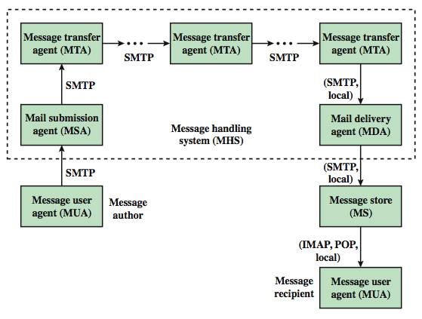
Internet Mail Architecture
Notes:
To understand to operation of DKIM, it is useful to have a basic grasp of the Internet mail architecture, as illustrated in Stallings Figure 7.9. At its most fundamental level, the Internet mail architecture consists of a user world in the form of Message User Agents (MUA), and the transfer world, in the form of the Message Handling Service (MHS), which is composed of Message Transfer Agents (MTA). A MUA is usually housed in the user's computer, and referred to as a client email program, or on a local network email server. The MHS accepts a message from one User and delivers it to one or more other users, creating a virtual MUA-to-MUA exchange environment. The MSA accepts the message submitted by an MUA and enforces the policies of the hosting domain and the requirements of Internet standards. This function may be co-located with the MUA or be a separate functional model. In the latter case, the Simple Mail Transfer Protocol (SMTP) is used between the MUA and the MSA. The MTA relays mail for one application-level hop. Relaying is performed by a sequence of MTAs, until the message reaches a destination MDA. The MDA is responsible for transferring the message from the MHS to the MS. An MS can be located on a remote server or on the same machine as the MUA. Typically, an MUA retrieves messages from a remote server using POP (Post Office Protocol) or IMAP (Internet Message Access Protocol). Also an administrative management domain (ADMD) is an Internet email provider. The Domain Name System (DNS) is a directory lookup service that provides a mapping between the name of a host on the Internet and its numerical address.

Slide 36
Email Threats
see RFC 4684- Analysis of Threats Motivating DomainKeys Identified Mail
describes the problem space in terms of:
  range: low end, spammers, fraudsters
  capabilities in terms of where submitted, signed, volume, routing naming etc
  outside located attackers
Notes:
RFC 4684 (Analysis of Threats Motivating DomainKeys Identified Mail) describes the problem space being addressed by DKIM in terms of the characteristics, capabilities, and location of potential attackers. It characterizes the range of attackers on a spectrum of three levels of threat: low end attackers who simply want to send email that a recipient does not want to receive, often with falsified sender addresses. At the next level are professional senders of bulk spam mail. The most sophisticated and financially motivated senders of messages are those who stand to receive substantial financial benefit, such as from an email-based fraud scheme. The RFC then lists a range of capabilities that an attacker might have in terms of where submitted, signed, volume, routing naming etc (see text). DKIM focuses primarily on attackers located outside of the administrative units of the claimed originator and the recipient.

Slide 37
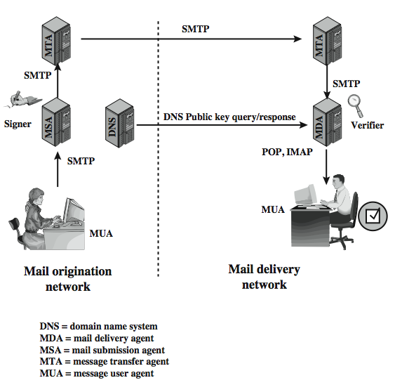
DKIM Strategy
transparent to user
  MSA sign
  MDA verify
for pragmatic reasons
Notes:
DKIM is designed to provide an email authentication technique transparent to the end user. In essence, a user's email message is signed by a private key of the administrative domain from which the email originates. The signature covers all of the content of the message and some of the RFC 5322 message headers. At the receiving end, the MDA can access the corresponding public key via a DNS and verify the signature, thus authenticating that the message comes from the claimed administrative domain. Thus, mail that originates from somewhere else but claims to come from a given domain will not pass the authentication test and can be rejected. This approach differs from that of S/MIME and PGP, which use the originator's private key to sign the content of the message, for various pragmatic reasons (see text).
Stallings Figure 7.10 shows a simple example of the operation of DKIM. An email message is generated by an email client program. The content of the message, plus selected RFC 5322 headers, is signed by the email provider using the provider's private key. The signer is associated with a domain, which could be a corporate local network, an ISP, or a public email facility such as gmail. The signed message then passes through the Internet via a sequence of MTAs. At the destination, the MDA retrieves the public key for the incoming signature and verifies the signature before passing the message on to the destination email client. The default signing algorithm is RSA with SHA-256. RSA with SHA-1 may also be used.

Slide 38
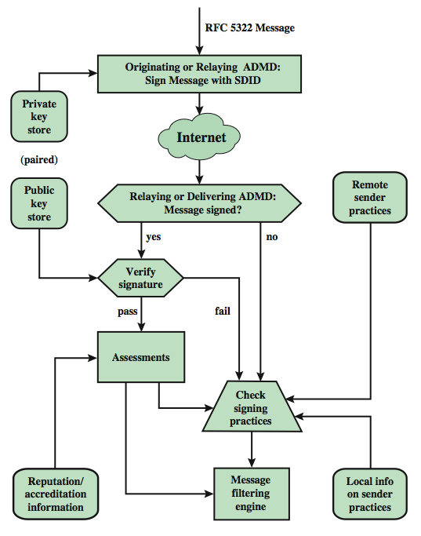
DCIM Functional Flow
Notes:
Stallings Figure 7.11 provides a more detailed look at the elements of DKIM operation. Basic message processing is divided between a signing Administrative Management Domain (ADMD) and a verifying ADMD. Signing is performed by an authorized module within the signing ADMD and uses private information from a Key Store. Verifying is performed by an authorized module within the verifying ADMD. The module verifies the signature or determines whether a particular signature was required. Verifying the signature uses public information from the Key Store. If the signature passes, reputation information is used to assess the signer and that information is passed to the message filtering system. If the signature fails or there is no signature using the author's domain, information about signing practices related to the author can be retrieved remotely and/or locally, and that information is passed to the message filtering system.
The signature is inserted into the RFC 5322 message as an additional header entry, starting with the keyword Dkim-Signature. Before a message is signed, a process known as canonicalization is performed on both the header and body of the RFC 5322 message. Canonicalization is necessary to deal with the possibility of minor changes in the message made en route. The signature includes a number of fields, as listed in the text.

Slide 39
Header fields in MIME
MIME-Version: Must be “1.0” -> RFC 2045, RFC 2046
Content-Type: More types being added by developers (application/word)
Content-Transfer-Encoding: How message has been encoded (radix-64)
Content-ID: Unique identifying character string.
Content Description: Needed when content is not readable text (e.g.,mpeg)

Slide 40
S/MIME Functions
Enveloped Data: Encrypted content and encrypted session keys for recipients.
Signed Data: Message Digest encrypted with private key of “signer.”
Clear-Signed Data: Signed but not encrypted.
Signed and Enveloped Data: Various orderings for encrypting and signing.

Slide 41
Algorithms used
Message Digesting: SHA-1 and MDS
Digital Signatures: DSS
Secret-Key Encryption: Triple-DES, RC2/40 (exportable)
Public-Private Key Encryption: RSA with key sizes of 512 and 1024 bits, and Diffie-Hellman (for session keys).

Slide 42
User Agent Role
S/MIME uses Public-Key Certificates - X.509 version 3 signed by Certification Authority
Functions:
  Key Generation - Diffie-Hellman, DSS, and RSA key-pairs.
  Registration - Public keys must be registered with X.509 CA.
  Certificate Storage - Local (as in browser application) for different services.
  Signed and Enveloped Data - Various orderings for encrypting and signing.

Slide 43
User Agent Role
Example: Verisign (www.verisign.com)
  Class-1: Buyer’s email address confirmed by emailing vital info.
  Class-2: Postal address is confirmed as well, and data checked against directories.
  Class-3: Buyer must appear in person, or send notarized documents.

Slide 44
Recommended Web Sites
PGP Key Management
PGP home page: www.pgp.com
MIT distribution site for PGP
S/MIME Charter
S/MIME Central: RSA Inc.’s Web Site

